Slide 1
Android Programming
Notes:
Introduce Richard
Start with Course Outline – Talk about only third time course has been offered so there will be changes

Slide 2
Getting Started
Android is the most popular mobile operating system in use today.
Can run on many different types of devices:
Smart phones
Tablets
TVs
Wearables (Watches, etc)
Cars

Slide 3
What is Android?
A mobile operating system based on a modified version of Linux
Originally developed by a company called Android Inc.
Bought by Google in 2005, as part of its strategy to enter the mobile market
By buying Android Inc. Google was able to gain ownership of its development work as well as its development team

Slide 4
What is Android
Google wanted Android to be and open system, hence most of the Android code was released under the open-source Apache License.
Means that vendors can tweak the code or customize Android by adding their own proprietary extensions to it thus differentiating themselves from other vendors (aka bloatware)
Means that many mobile companies switched to Android O/S while continuing to develop their own hardware

Slide 5
What is Android
Developers develop for Android, and the applications should be able to work on many different types of hardware
Android is changing quickly 4 major releases in last 4 years up to Android v7.0 now
Access to a lot of different software that has been designed for Android and distributed to the Google Play Store

Slide 6
Android Version
The first official release was 1.1 on February 9, 2009 (Beta).
Releases have been code-named after foods since C
3.x, early 2011 – Honeycomb
Provided support for large screen devices
4.0, late 2011 – Ice Cream Sandwich
Combined phones and tablets
4.1-4.3 – Jelly Bean – Very common (July 2013)
Support for improved devices (Braille, NFC, Beam, multi-users)
4.4-4.4.4 – KitKat (October 2013)
Better battery life and updated kernel
Started W series (4.4W.2)
Notes:
3.0 – USB support, large screens, external keyboards, multicore processors
Currently at 5.1.1 (Lollipop) and release 22 of API

Slide 7
Current Android Versions
5.0-5.1.1 – Lollipop (November, 2014)
Released on most new phones now
Contains some vulnerabilities (most notably StageFright)
6.0 – Marshmallow (October, 2015)
Ready to be used, but not on many phones
7.0 Nougat (August, 2016)

Slide 8

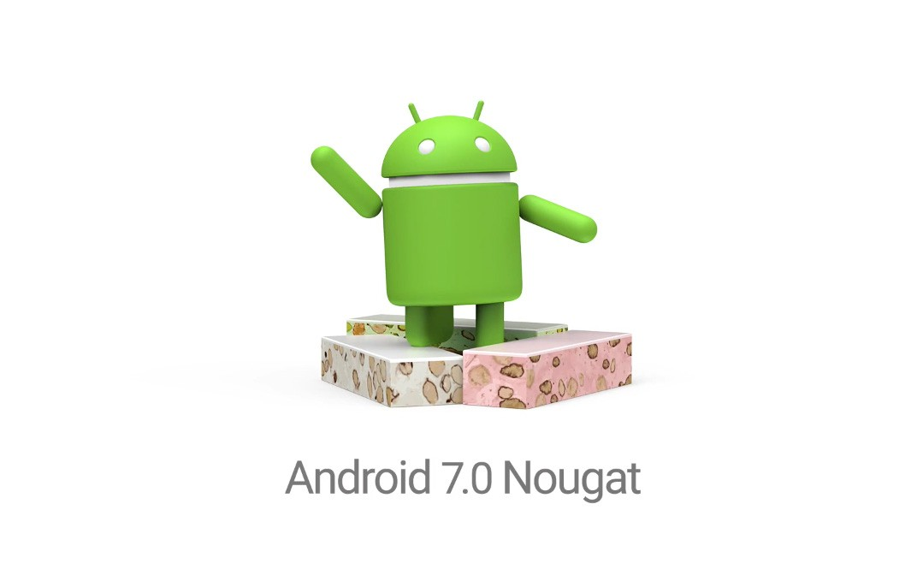
Notes:
Take a look at the Android tablets now
Phones/tablets
Two types – 2012 and current ones – some basic differences such as size, weight, camera
Same version of O/S and chipset and same libraries so it shouldn’t make a difference to what we are doing.
Also have one Nexus 6/9 – different chipset – different set of problems
Multiple pages on the device although nothing on any pages except the first one
4 browsers
Voice recorder and camera (for C10)
Bottom row – Chrome browser, ES File explorer, Uninstaller, Learn programming, Socrative
6 dots in the middle bring up a list of all applications. When you create an app and install it, you may need to go there to find it
Swipe down from top – see the top status bar – second time will see details choose the gear and bring up settings
Go to About Tablet – At bottom there is a build number (Actually means something) – need to tap it 7 times to turn on developer options
Go to Developer options – make sure USB debugging is turned on and Verify Apps over USB turned off
Go to Security Options – Unknown sources is turned on

Slide 9
Versions and API Level
API is the revision within the Software Development Kit
Does not match up with Android version in any meaningful way
Jelly Bean – API 16-18
Kit Kat – API 19
Lollipop – API 21-22
Marshmallow – API 23
Nougat – API 24
(Yes I know 20 is missing – it was only for Wearables)
Notes:
For example Gingerbread – API 9-10; Honeycomb – API 11-13
We’re concerned with API 19 and above – when you create an application you will be prompted for the LOWEST version of API you want for your app
Marshmallow will be API 23

Slide 10
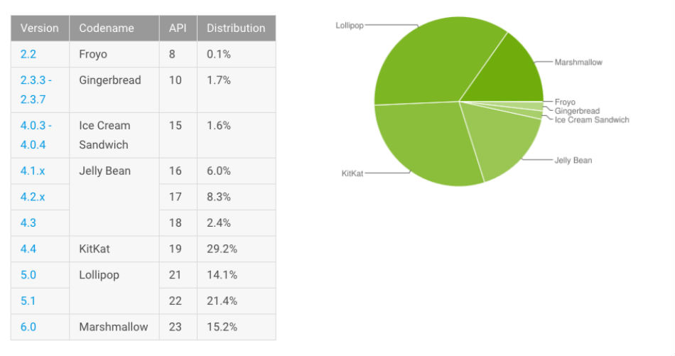
Android Version Penetration August, 2016

Slide 11
Android Programming
The Java SE development kit
From first year
Android Studio
Provides IDE for creating apps
Can use Eclipse
Add Android SDK
Add ADT plug-in for Eclipse
Notes:
Do NOT use Eclipse – I will be building in Android Studio – it’s supposed to convert – it likely won’t
Start Android Studio
Settings -> SDK Manager – Where the software development kits for development are found – only 19 and above should be installed
It will have selected the M API 23 level to install – do not install it
Previous page and create a new project – Call Application your initialsEG1; Company name your ID.heritage; change location to H drive in proper folder
Click Next and here’s where you choose the minimum version
Next and choose what framework to add – choose Blank Activity
Next and comes to Activity information – Change Title to Example 01 – initials
Blank page – click on Project on left side – app and Gradle
Open up AndroidManifest.xml – Explain activity, icon and label too
Open up java and see MainActivity – three methods OptionsMenu are later, today we’re concerned with onCreate
Open up res/layout and see activity_main.xml – deal rendering issues
Show XML equivalent
Plug in device and try and run – no devices – Device Manager and add from android studio
Run Hello World App again
Add a bunch of other widgets. MUST add a button and another textView.
Show rest of res fils – mipmap; values – show strings and dimens…
- Open Android Manifest and make it use @string resources
- Open activity_main and do same for dimens and string resources
Back to java… update
Explain findViewById - declare button
Now need to declare a listener
Use setText to change the text of the TextView
On their own - Toggle the text on each button press
On their own - Change text in different text view on each button press
REMEMBER - use resource files!

Slide 12
Android Virtual Devices
If you do not have an Android device to debug on, you can use the emulator that comes with the Android SDK.
The emulator is referred to and Android Virtual Device or AVD.
An AVD is an emulator instance that enables you to model an actual device.

Slide 13
Android Virtual Devices
Each AVD consists of a hardware profile, a mapping to a system image, as well as emulated storage such as an SD card.
The advantage of using AVDs is that you can emulate and test on virtually any device platform without having to own the actual hardware.
You can create as many AVDs as you want in order to test your applications with several different configurations.
The testing is important to see the behaviour of your application when it is run on different devices with varying capabilities.

Slide 14
Using the AVD
To start the emulator, highlight it in the list and click Start... You can skip the launch options for now and just click Launch.
The first time you launch a new AVD, it will take a long time to start up.
The second and subsequent times you start the AVD, it will come up a bit faster
You do not need to stop and restart the emulator every time you want to test your application, in most cases
Issues between when you have a device plugged in and when you don’t
Notes:
Create an AVD – Create one for Nexus 9 and 5x – Use defaults – Run app in AVD. Create one for both types of Nexus 7 and do the same.

